Slide 1
Programming with Algebra
André van Delft
Anatoliy Kmetyuk
LambdaConf
Boulder, Colorado
26 May 2016
www.subscript-lang.org

Slide 2
Overview
Introduction
SubScript Examples
Semantic Model
Algebra of Communicating Processes
VM
Hands on: Debugger
https://github.com/scala-subscript/examples
https://github.com/scala-subscript/koans
Syntax Matters
Hands on: Koans, Example
Conclusion

Slide 3
Programming is Still Hard
Mainstream programming languages: imperative
good in batch processing
not good in parsing, concurrency, event handling
Callback Hell
Neglected idioms
Non-imperative choice: BNF, YACC
Data flow: Unix pipes
Math!
https://github.com/scala-subscript/examples
https://github.com/scala-subscript/koans

Slide 4


Programming Paradigms
Parboiled
FastParse
SubScript
Smalltalk
Scala
Java 8
Lisp
Haskell
λ
Prolog
Declarative
JavaCC
YACC
sh
Imperative
Imperative
C++
Java 1..7
Objects
Assembly, C

Slide 5
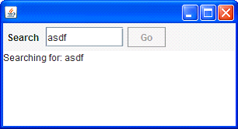
GUI application - 1
Input Field
Search Button
Searching for…
Results
Notes:
Example: a typical search application. Simple on the outside, but still hard to program.
On clicking the search button, a message “Searching for: …” appears in the text area, and the button is disabled.
Meanwhile a background task starts to search on the Internet or in a database. This may last some time.
When the background task is ready the results should be displayed, and the buttun should be enabled again. This must happen in the GUI thread.

Slide 6
GUI application - 2
val searchButton = new Button("Go”) {
reactions.+= {
case ButtonClicked(b) =>
enabled = false
outputTA.text = "Starting search...”
new Thread(new Runnable {
def run() {
Thread.sleep(3000)
SwingUtilities.invokeLater(new Runnable{
def run() {outputTA.text="Search ready”
enabled = true
}})
}}).start
}
}
Notes:
A typical solution in Scala; in Java it would be similar.
Much indentation and many braces.
Hard program code.
The text suggests top-down order, but there is some flow in the opposite direction.
Costly, boring and error-prone.

Slide 7
GUI application - 3
live = clicked(searchButton)
@gui: let outputTA.text="Starting search.."
do* Thread.sleep(3000)
@gui: let outputTA.text="Search ready"
...
Sequence operator: white space and ;
gui: code executor for
SwingUtilities.InvokeLater+InvokeAndWait
do* ... : by executor for new Thread
Enable/disable button: for free
searchButton
Notes:
Solution in SubScript.
None of the lines are executed in normal mode:
“clicked” is a user action
@gui: indicates execution in GUI thread
“{* …* *} indicates execution in new thread
“…” is “etcetera”; “while(true)” would do the same
Definitions using “=“, just like in algebra, and in Scala

Slide 8
GUI application - 4
live = searchSequence...
searchSequence = searchCommand
showSearchingText
searchInDatabase
showSearchResults
searchCommand = searchButton
showSearchingText = @gui: let outputTA.text = "…"
showSearchResults = @gui: let outputTA.text = "…"
searchInDatabase = do* Thread.sleep(3000)
Notes:
Solution in SubScript with more refinements.

Slide 9
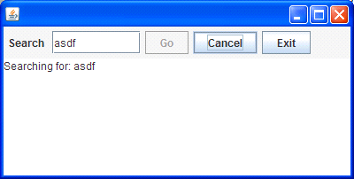
GUI application - 5
Search: button or Enter key
Cancel: button or Escape key
Exit: button or ; ; “Are you sure?”…
Search only allowed when input field not empty
Progress indication
Notes:
Extra requirements to make the application more user friendly

Slide 10
GUI application - 6
live = searchSequence...
|| exit
searchCommand = searchButton
+ Key.Enter
cancelCommand = cancelButton + Key.Escape
exitCommand = exitButton + windowClosing
exit = exitCommand @gui: confirmExit ~~> while !_
cancelSearch = cancelCommand @gui: showCanceledText
searchSequence = searchGuard searchCommand
showSearchingText searchInDatabase showSearchResults
/ cancelSearch
searchGuard = if !searchTF.text.isEmpty then break? anyEvent:searchTF ...
searchInDatabase = progressMonitor || do* Thread.sleep: 3000
progressMonitor = do* Thread.sleep: 250
@gui: let searchTF.text+=here.pass
...
Notes:
live– 2 parallel process, with “or” logic: ready when exit is ready.
Exit awaits command; then asks “Are you sure”. Stops after “Yes”, else iterates
Command: button or key or close box
searchGuard: guards searchCommand – only active when text field is non empty
white space – sequence, strong binding
; - sequence, weak binding
/ - right hand side may disrupt left hand side
progressMonitor: wait ¼ sec; write counter to text area; iterated. Or-parallel

Slide 11
Example: Slick 3
Reactive Streams for Asynchronous Database Access in Scala
http://www.infoq.com/news/2015/05/slick3
val q = for (c<-coffees) yield c.name
val a = q.result
val f: Future[Seq[String]] = db.run(a)
f.onSuccess { case s => println(s"Result: $s") }
val q = for (c<-coffees) yield c.name
q ~~(s)~~> println: s"Result: $s"

Slide 12
SubScript Actors: Ping Pong
class Ping(pong: ActorRef) extends Actor {
override def receive: PartialFunction[Any,Unit] = {case _ =>}
pong ! "Hello"
pong ! "Hello"
pong ! "Terminate"
}
class Pong1 extends SubScriptActor {
override def receive: PartialFunction[Any,Unit] = {
case "Hello" => println("Hello")
case "Terminate" => println("Done" ); context.stop(self)
}
}
class Pong2 extends SubScriptActor { var ping: ActorRef
script ..
live = ping ~~("Hello" )~~> println: "Hello" ...
/ ping ~~("Terminate")~~> println: "Done"
}

Slide 13
SubScript Actors: DataStore - 1
DataRequest
data
An Actor
DataRequest
(data, details)
Proxy
Store
DetailsRequest
details
class DataStore extends Actor {
def receive = {
case DataRequest(name) => sender ! getData (name)
case DetailsRequest(data) => sender ! getDetails(data)
}
}

Slide 14
SubScript Actors: DataStore - 2
class DataProxy(dataStore: ActorRef) extends Actor {
def waitingForRequest = {
case req: DataRequest =>
dataStore ! req
context become waitingForData(sender)
}
def waitingForData(requester: ActorRef) = {
case data: Data =>
dataStore ! DetailsRequest(data)
context become waitingForDetails(requester, data)
}
def waitingForDetails(requester: ActorRef, data: Data) = {
case details: Details =>
requester ! (data, details)
context become waitingForRequest
}
}

Slide 15
SubScript Actors: DataStore - 3
DataRequest
data
An Actor
DataRequest
(data, details)
Proxy
Store
DetailsRequest
details
class DataProxy(dataStore: ActorRef) extends SubScriptActor {
script live =
?anActor:ActorRef ~~( req: DataRequest)~~> {dataStore ? req}
~~( data: Data )~~> {dataStore ? DetailsRequest:data}
~~(details: Details )~~> do anActor ! (data, details)
...
}

Slide 16
Algebra can be easy and fun
Area | Objects | Operations | Rules
Numbers | 0, 1, ..., x, y, ... | + ･ - / | x+y = y+x
Logic | F, T, x, y, ... | ∨ ∧ ￢ | x∨y = y∨x
Processes | 0, 1, a, b,..., x, y, ... | + ･ & | && || / | x+y = y+x

Slide 17
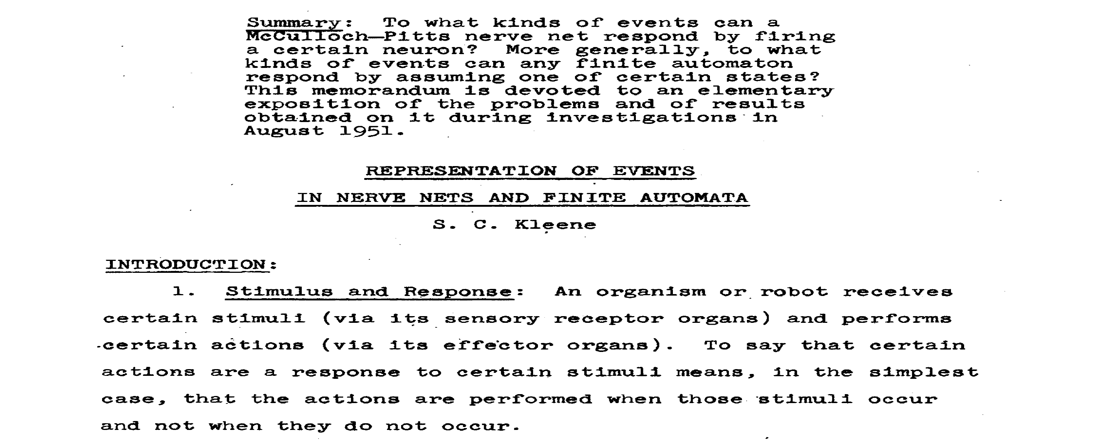
Kleene, 1951 - 1

Slide 18
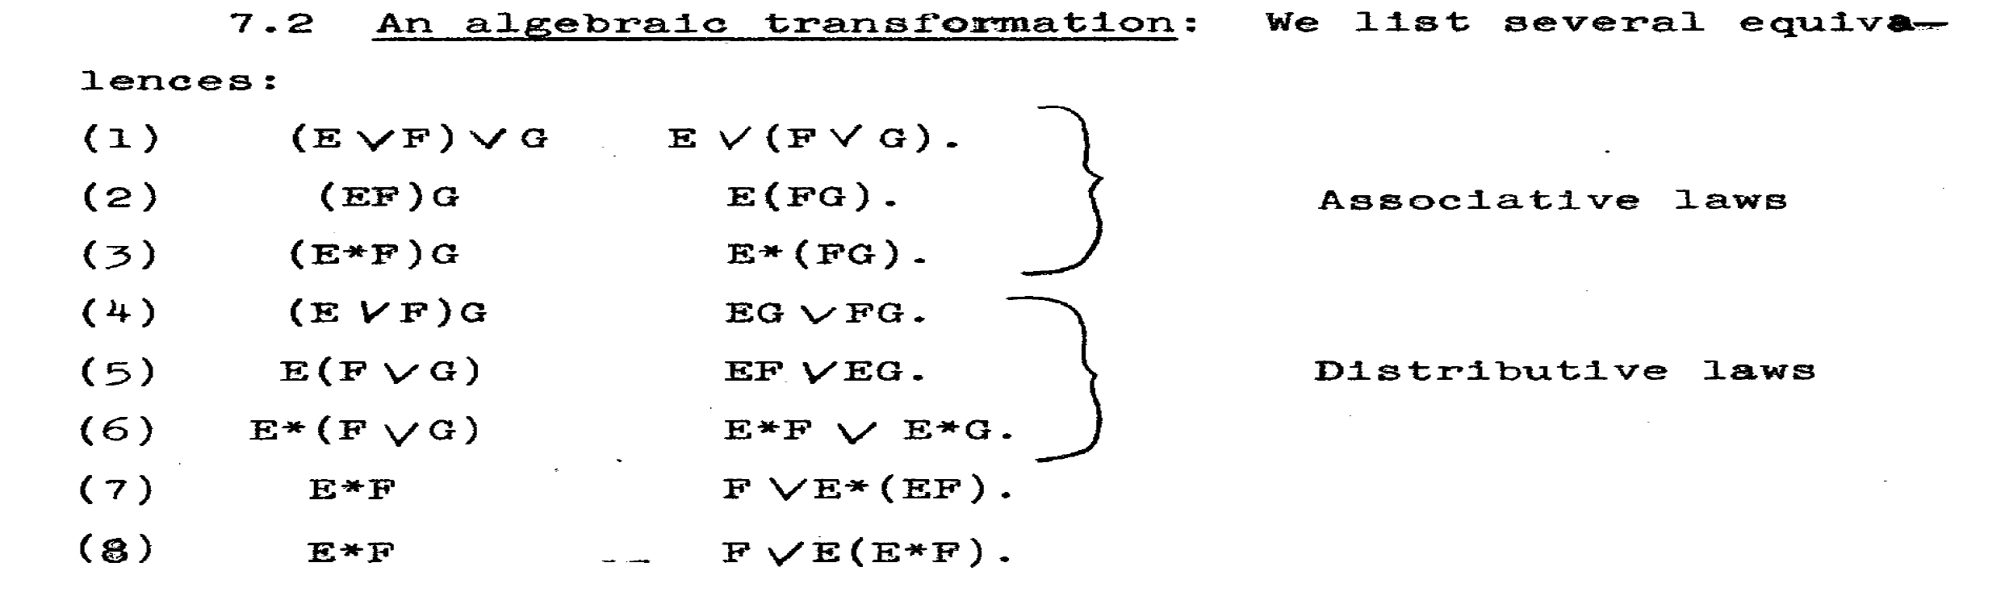
Kleene, 1951 - 2

Slide 19
Some History
1955 Stephen Kleene ~~> regular expressions, *
Noam Chomsky ~~> language grammars
1960 John Backus & Peter Naur ~~> BNF
Tony Brooker ~~> Compiler Compiler
1971 Hans Bekič ~~> Algebra of Processes
1973 Stephen Johnson ~~> YACC
1974 Nico Habermann & Roy Campbell ~~> Path Expressions
1978 Tony Hoare ~~> Communicating Sequential Processes (CSP)
1980 Robin Milner ~~> Calculus of Communicating Systems (CCS)
1982 Jan Bergstra & Jan Willem Klop ~~> Algebra of Communicating Processes (ACP)
1989 Robin Milner ~~> Pi-Calculus
Henk Goeman ~~> Self-applicative Processes

Slide 20
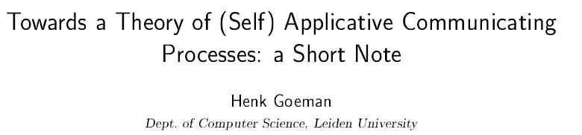
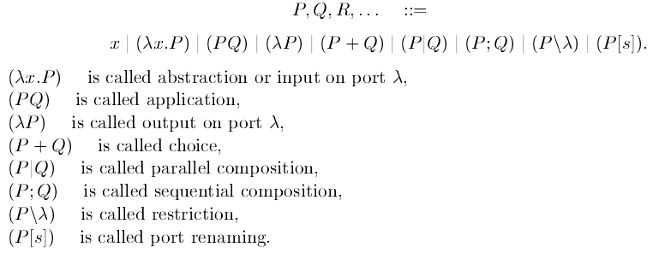
Goeman 1989 - 1

Slide 21
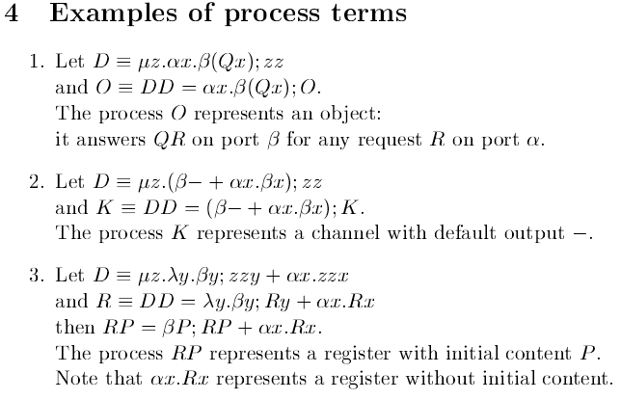
Goeman 1989 - 2

Slide 22
Algebra of Communicating Processes - 1
Bergstra & Klop, Amsterdam, 1982 - ...
ACP ~ Boolean Algebra
+ choice
· sequence
0 deadlock
1 empty process
atomic actions a,b,…
parallelism
communication
disruption, interruption time, space, probabilities
money
...

Slide 23
Algebra of Communicating Processes - 2
Less known than CSP, CCS
Specification & Verification
Communication Protocols
Production Plants
Railways
Coins and Coffee Machines
Money and Economy
Strengths
Familiar syntax
Precise semantics
Reasoning by term rewriting
Events as actions

Slide 24
Algebra of Communicating Processes - 3
x+y = y+x (x+y)+z = x+(y+z) x+x = x (x+y)·z = x·z+y·z (x·y)·z = x·(y·z)
0+x = x 0·x = 0 1·x = x x·1 = x
(x+1)·y
= x·y + 1·y
= x·y + y

Slide 25
Algebra of Communicating Processes - 4
x║y = x╙y + y╙x + x|y
(x+y)╙z = ... a·x╙y = ... 1╙x = ... 0╙x = ... (x+y)|z = ... ... = ...
Notes:
Process terms are rewritable to 4 simple forms.
This eases axiomatic definition of new operators
Parallelism is a choice: left first and then the rest in parallel, or right first and then the rest in parallel, or communicatieirst and then the rest

Slide 26
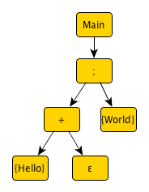
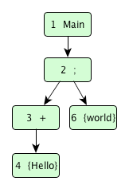
Implementation - 1
Main = (Hello + 1) · World
import subscript.DSL._
def Main = _script('Main) { _seq(_alt(_normal{here=>Hello}, _empty), _normal{here=>World} ) }
def main(args: Array[String]): Unit = _execute(Main)
Virtual Machine: 2500 code lines
static script trees
dynamic Call Graph
here there
onActivate onSuccess

Slide 27
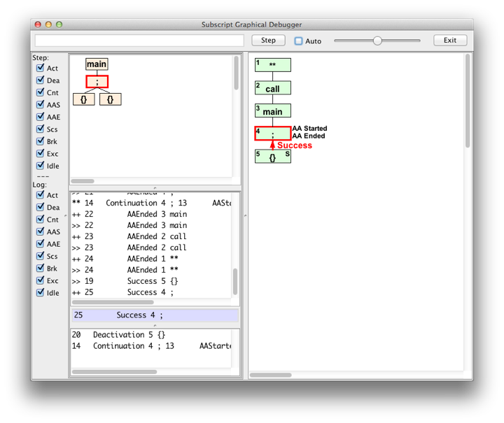
Debugger - 1

Slide 28
Hands On - 1
https://github.com/scala-subscript/examples
git clone https://github.com/scala-subscript/examples.git
cd examples
sbt
> project helloworld
> set mainClass in Compile := Some("subscript.example.Hello")
> ssDebug
Edit file:
examples/helloworld-example/src/main/scala/subscript/example/Hello.scala
Hello
Hello; World
Hello+[+]; World

Slide 29
ACP Language Extensions
1980: Jan van den Bos - Input Tool Model [Pascal, Modula-2]
1988-2011: André van Delft - Scriptic [Pascal, Modula-2, C, C++, Java]
1994: Jan Bergstra & Paul Klint - Toolbus
2011-...: André van Delft - SubScript [Scala, JavaScript (?)]
Application Areas:
GUI Controllers
Text Parsers
Discrete Event Simulation
Reactive, Actors, Dataflow

Slide 30
Debugger - 2
built using SubScript
live = stepping || exit
stepping = {* awaitMessageBeingHandled *}
if shouldStep then [
@gui: {: updateDisplay :}
stepCommand || if autoCheckBox.selected then sleepStepTimeout
]
{: messageBeingHandled(false) :}
...
exit = exitCommand
var isSure = false
@gui: {!isSure = confirmExit!}
while !isSure
exitCommand = exitButton + windowClosing

Slide 31
Syntax Matters - 1
ACP: Main = (Hello + 1) · World
import subscript.DSL._
def Main = _script('Main) { _seq(_alt(_normal{here=>Hello}, _empty), _normal{here=>World} ) }
Improve with specific syntax; mainly simple Sugar
Goals:
DRY, less Boilerplate code
Few (Parentheses), {Braces}, [Brackets]
Few vars
Refinement support
Base layer with symbols, not keywords
Top layer with well readable words
Clear boundaries Scala <==> SubScript

Slide 32
Syntax Matters - 2
ACP: Main = (Hello + 1) · World
import subscript.DSL._
def Main = _script('Main) { _seq(_alt(_normal{here=>Hello}, _empty), _normal{here=>World} ) }
Year | Solution
2011 | subscript.DSL
2012 | Scalac branch: scanner, parser, typer
2015 | Parboiled2 preprocessor + macros
2016... 2016... | FastParse + Dotty

Slide 33
Syntax Matters - 3
ACP: Main = (Hello + 1) · World
import subscript.DSL._
def Main = _script('Main) { _seq(_alt(_normal{here=>Hello}, _empty), _normal{here=>World} ) }
Influences
Scala
ACP
YACC
Prolog, Linda
Basic
Smalltalk
Unix sh
FastParse

Slide 34
Syntax Matters - 4
Construct | ACP | SubScript
Deadlock process | 0 | [-]
Empty process | 1 | [+]
Neutral process | 0 or 1 | []
Neutral code |  | {: scala :}
Atomic actions | a, b, ... | {! scala !} {* *} {. .}
Choice | x+y | x+y
Sequence | x·y | x y x;y
Expression parentheses | (x+y)·z | [x+y] z x+y;z
Parallelism | x‖y | x&y x|y x&&y x||y
Sequential Iteration | x*y | ..? x; y
Iterators | ∑ ∏ ‖ | ..? ... while for
Break from expression |  | break? break
Process launching | cr(x) | [*x*]
Communication | a,b = c | shared scripts: multiple callers

Slide 35
Syntax Matters - 5
Construct | SubScript
N-ary Operators | whitespace ; + & && | || /
Grouping | [...]
Special terms | [+] [-] [] ..? ... while for break? break
Code fragments | {@ scala @} for @ in :, !, ?, *, ., ...
Annotations, call graph node | @there.onDeactivate{...}: here.pass
Declarations | val, var
Output parameters | s( ?i:Int) s(?i) ?i ?j:Int
Constrained parameters | t(??i:Int) t(?i) t(?i ?if(_>3)) t(5)
Control | if-then-else do-then-else
Dataflow map | ~~^ ~/~^ ~~^ +~/~^
Dataflow flatmap | ~~> ~/~> ~~> +~/~>
Result values | Script[T] x^ x^^ x^^1 ^x
Scala terms | true 1 'a' "A" p p.q p.q(r) (..) {...}

Slide 36
Syntax Matters - 6
resolve(termType) =
termType match {
case t: Unit => neutralCodeFragment
case t: Script[_] => scriptCall
case other => findImplicitConversionsFor(other) match {
case List(c) if c isInstanceOf[Unit]
|| c.isInstanceOf[Script[_]]
=> resolve(c.type)
case _ => error
}
}

Slide 37
Syntax Matters - 7
resolve(termType) =
^termType
~~(t: Unit )~~^ neutralCodeFragment
+~~(t: Script[_])~~^ scriptCall
+~~(other )~~^ ^findImplicitConversionsFor: other
~~(List(c) if c isInstanceOf[Unit]
|| c.isInstanceOf[Script[_]]
)~~^ resolve: c.type
+~~^ error
([x]) = ???

Slide 38
Syntax Matters - 8
ACP: Main = (Hello + 1) · World
import subscript.DSL._
def Main = _script('Main) { _seq(_alt(_normal{here=>Hello}, _empty), _normal{here=>World} ) }
Less boilerplate code,
(Parentheses), {Braces}
Process 𝝺 in Scala expressions
[ subscript expression syntax ]
import subscript.language
def Main = [ {!Hello!} + []; {!World!} ]
Few [Brackets]
script keyword
script Main = {!Hello!} + []; {!World!}

Slide 39
Syntax Matters - 9
script searchCommand = searchButton
script showSearchingText = @gui: {: outputTA.text = "…" :}
script showSearchResults = @gui: {: outputTA.text = "…" :}
script searchInDatabase = {* Thread.sleep(3000) *}
Top layer with well readable words
Use let and do
script searchCommand = searchButton
script showSearchingText = @gui: let outputTA.text = "…"
script showSearchResults = @gui: let outputTA.text = "…"
script searchInDatabase = do* Thread.sleep(3000)
DRY
script .. section
script ..
searchCommand = searchButton
showSearchingText = @gui: let outputTA.text = "…"
showSearchResults = @gui: let outputTA.text = "…"
searchInDatabase = do* Thread.sleep(3000)
// .. also for Scala (trait, class, def, val, var, ...)?

Slide 40
Syntax Matters - 10
Construct | Base form | Less {Braces}
Neutral code | {: scalaCode :} | let scalaCode
Atomic action | {! scalaCode !} | do! scalaCode
Threaded code | {* scalaCode *} | do* scalaCode
Event handling code | {. scalaCode .} | do. scalaCode
Persistent event handler | {... scalaCode ...} | do... scalaCode

Slide 41
Hands On - 2
https://github.com/scala-subscript/koans
Download; unzip to koans/
cd koans
sbt
> koans
Edit; retry; ...

Slide 42
github.com/scala-subscript/koans
package subscript.koans
import subscript.language
import subscript.Predef._
import subscript.koans.util.KoanSuite
class AboutSubScript extends KoanSuite {
koan(1)(
"""
| Imports, scripts and atomic actions:
|
| To use SubScript in a file, it should have these two import statements:
|
| `import subscript.language`
| ...
"""
) {
var flag = false
script foo = {! flag = true !}
test(1) { runScript(foo); flag shouldBe __ }
}

Slide 43
Syntax Matters - 11
ACP: a*b
someA_B = [..?; a]; b
Less boilerplate
whitespace instead of ;
someA_B = [..? a] b
Few [Brackets]
mix whitespace and ;
someA_B = ..? a; b

Slide 44
Syntax Matters - 12
searchCommand = clicked(searchButton) + pressed(Key.Escape)
cancelCommand = clicked(cancelButton) + pressed(Key.Escape)
exitCommand = clicked( exitButton) + windowClosing
DRY
Implicit Conversions
searchCommand = searchButton + Key.Escape
cancelCommand = cancelButton + Key.Escape
exitCommand = exitButton + windowClosing

Slide 45
Syntax Matters - 13
key(c: FormalConstrainedParameter[Int]) =
key(top, AdaptingParameter(c, {c = _}))
var c = 0
key(ActualOutputParameter( c, {c = _}))
key(ActualConstraintParameter(c, {c = _}, {_<64}))
key(ActualValueParameter('x'))
Shorthand notations
Prolog, Linda style
DRY, Refinement support
key(??c: Int) = key(top, ??c)
var c = 0
key(?c)
key(?c ?if(_<64))
key('x')

Slide 46
Syntax Matters - 14
var c = 0
key(?c)
DRY
Implicit call
var c = 0
?c
DRY
Implicit val decl
?c: Int

Slide 47
Syntax Matters - 15
compute(?i: Int) = {: i= 10 :}
Less boilerplate
Result value
compute: Int = {: 10 :}^
Less boilerplate
Shorthand
compute: Int = {: 10 :}
compute: Int = ^10
compute^ println:"Ok"
naturalsUpTo(n: Int) = times:n ^pass^^

Slide 48
Syntax Matters - 16
naturalsUpTo(n: Int) = times:n ^pass^^
([x]) = x
in a 𝝺
[x]^ =def= ([x])^
naturalsWithSquaresUpTo(n: Int) = times:n [ ^ pass ^^1
^(pass*pass)^^2 ]^^

Slide 49
Syntax Matters - 17
x ~~(b:Boolean )~~> y1 +~~(i:Int if i<10)~~> y2 +~~( _ )~~> y3 +~/~(e:IOException)~~> z1 +~/~(e: Exception)~~> z2 +~/~(e: Throwable)~~> z3
x ~~> case b:Boolean => [y1] case i:Int if i<10 => [y2] case _ => [y3]
+~/~> case e:IOException => [z1] case e: Exception => [z2] case e: Throwable => [z3]
def x ~~> y +~/~> z =
{
var x_node: N_call[Any] = null
[ do @{x_node = there.asInstanceOf[N_call[Any]]}:
x
then y:x_node.$success ^
else z:x_node.$failure ^
]
}
match+catch
flatmap
map:
x ~~^ toString

Slide 50
Syntax Matters - 17
everyIntervalLaunch(d: Duration, p: Script[_]) = wait:d [*p*] ...
everyIntervalLaunch(5*second, [x;y] )
Less nested parentheses
Smalltalk-style calls
everyInterval: (5*second), launch: [x;y]

Slide 51
github.com/scala-subscript/examples
helloworld
lookupframe
life
filedownloader
pingpong
storage
subscript-twitter-search
taskprocessor

Slide 52
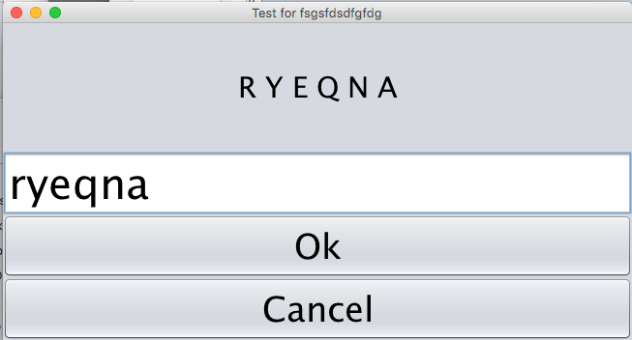
github.com/scala-subscript/eye-test
script..
live = mainTestProcess^ / cancelBtn
mainTestProcess = eyeTest("Right")^^1
eyeTest("Left" )^^2
eyeTest(eyeName: String)
= let testArea.font = new Font("Ariel", java.awt.Font.PLAIN, 20)
let testArea.text = s"<html>Look with your $eyeName eye.</html>"
let answerField.enabled = false
sleep: 250
Key.Enter + okBtn
doTest( if(eyeName=="Right") previousScoreRight else previousScoreLeft )^

Slide 53
Hands On - 3
https://github.com/scala-subscript/examples
cd examples
sbt
> projects
> project lookupframe
> run
Multiple main classes detected, select one to run:
[1] subscript.example.LookupFrame
[2] subscript.example.LookupFrame2
[3] subscript.example.LookupFrame2TBD
Enter number: 3
Edit file according to guidelines:
lookup-example/src/main/scala/subscript/example/LookupFrame2TBD.scala
storage/src/main/scala/subscript/example/StorageTBD.scala
subscript-twitter-search/src/main/scala/subscript/twitter/app/controller/
SubScriptControllerTBD_Futures.scala

Slide 54
Open Source Project
subscript-lang.org github.com/scala-subscript
10^4...10^5 actions per second
Simple implementation: 6000 lines, 50%
Scalac branch ~~> Parboiled + Macro's
VM
scripts for actors, swing
Jetbrains - IntelliJ Plugin
ScalaParse + Dotty

Slide 55
FastParse & ScalaParse
http://www.lihaoyi.com/fastparse/
Better error messages than Parboiled2
Inspiration for SubScript:
^ - normal result value
^^ - result values into List
^^1, ^^2 - result values into tuple
script..
s = var i= 0
var j=10
while(i<3) [^i^^1 ^j^^2]^^ {! i+=1; j-=1 !}
test(1) {runScript(s).$ shouldBe Success(List((0,10),(1,9),(2,8)))}

Slide 56
Conclusion
Programming great again with Algebra
Still much to do:
ScalaParse & Dotty
JS, NodeJS
ACP style communication
...
and to discover:
programming patterns
arXiv paper "Some New Directions in ACP Research"
To join the project: andre.vandelft@gmail.com
Sponsors also welcome

Slide 57
One-time Dataflow - 1
exit = exitCommand var isSure = false @gui: {: isSure = confirmExit :} while !isSure
Arrows + 𝝺's
exit = exitCommand @gui:{confirmExit} ~~> (r:Boolean) => [while !r]
exit = exitCommand @gui:{confirmExit} ~~> (r:Boolean) ==> while !r
exit = exitCommand @gui:{confirmExit} ~~> while !_
exit = exitCommand @gui:{confirmExit} ~~(r:Boolean)~~> while !r
exit = exitCommand @gui:{confirmExit} ~~(r)~~> while !r

Slide 58
One-time Dataflow - 2
Script result type script confirmExit:Boolean = ...
Result values $: Try[T]
Result propagation call^ {:result:}^
Data Flow x ~~> y
Exception Flow x~/~> y
Ternary x ~~> y +~/~> z
Matching flow: x ~~(b:Boolean )~~> y1 +~~(i:Int if i<10)~~> y2 +~~( _ )~~> y3 +~/~(e:IOException)~~> z1 +~/~(e: Exception)~~> z2 +~/~(e: Throwable)~~> z3

Slide 59
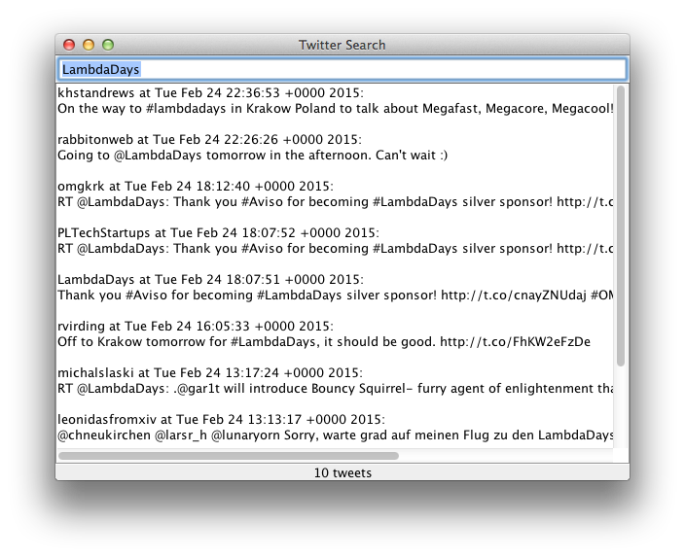
Example: Twitter Search Client - 1

Slide 60
Example: Twitter Search Client - 2
class PureController(val view: View) extends Controller with Reactor {
def start() = {initialize; bindInputCallback}
def bindInputCallback = {
listenTo(view.searchField.keys)
val fWait = InterruptableFuture {Thread sleep keyTypeDelay}
val fSearch = InterruptableFuture {searchTweets}
reactions += {case _ => fWait .execute()
.flatMap {case _ => fSearch.execute()}
.onComplete{case Success(tweets) => Swing.onEDT{view. ...()}
case Failure(e:CancelException) => Swing.onEDT{view. ...()}
case Failure( e ) => Swing.onEDT{view. ...()}
} } } }

Slide 61
Example: Twitter Search Client - 3
class SubScriptController(val view: View) extends Controller {
def start() = _execute(_live())
script..
live = initialize; [mainSequence/..?]...
mainSequence = anyEvent: view.searchField
waitForDelay
searchInBG ~~(ts:Seq[Tweet])~~> updateTweetsView:ts
+~/~(t: Throwable )~~> setErrorMsg:t
waitForDelay = {* Thread sleep keyTypeDelay *}
searchInBG = {* searchTweets *}
updateTweetsView(ts: Seq[Tweet]) = @gui: view.setTweets: ts
setErrorMsg (t : Throwable ) = @gui: view.setErrorMsg: t
}

Slide 62
Example: Twitter Search Client - 4
class SubScriptController(val view: View) extends Controller {
def start() = _execute(_live())
val fWait = InterruptableFuture {Thread sleep keyTypeDelay}
val fSearch = InterruptableFuture {searchTweets}
script..
live = initialize; [mainSequence/..?]...
mainSequence = anyEvent: view.searchField
fWait
fSearch ~~(ts:Seq[Tweet])~~> updateTweetsView:ts
+~/~(t: Throwable )~~> setErrorMsg:t
updateTweetsView(ts: Seq[Tweet]) = @gui: view.setTweets: ts
setErrorMsg (t : Throwable ) = @gui: view.setErrorMsg: t
}

Slide 63
Example: Twitter Search Client - 4
implicit script future2script[T](f:InterruptableFuture[T]): T
= @{f.execute() .onComplete {case aTry => there.executeForTry(aTry)}}: {. .}
implicit def script2future[T](s:Script[T]): InterruptableFuture[T]
= { ... }

Slide 64
SubScript Actors: DataStore - 3
class DataProxy(dataStore: ActorRef) extends SubScriptActor {
script live = << req: InformationRequest
=> dataStore ! req
==>
var response: (Data, Details) = null
<< data: Data
=> dataStore ! DetailsRequest:data
==>
<< details:Details => response = (data,details) >>
>>
{:sender ! response:}
>>
...
}

Slide 65
SubScript Actors: Implementation - 1
trait SubScriptActor extends Actor {
private val callHandlers = ListBuffer[PartialFunction[Any, Unit]]()
def _live(): ScriptNode[Any]
private def script terminate = Terminator.block
private def script die = {if (context ne null) context stop self}
override def aroundPreStart() {
runner.launch( [ live || terminate ; die ] )
super.aroundPreStart()
}
override def aroundReceive(receive: Actor.Receive, msg: Any) {
...
callHandlers.collectFirst {
case handler if handler isDefinedAt msg => handler(msg) } match {
case None => super.aroundReceive( receive , msg)
case Some(_) => super.aroundReceive({case _: Any =>}, msg)
} }
...
}

Slide 66

SubScript Actors: Implementation - 2
<< case a1: T1 => b1 ==> s1
case a2: T2 => b2 ==>
...
case an: Tn => bn ==> sn >>
r$(case a1: T1 => b1; [s1]
case a2: T2 => b2; null
...
case an: Tn => bn; [sn])
trait SubScriptActor extends Actor {
...
script r$(handler: PartialFunction[Any, ScriptNode[Any]]) =
var s:ScriptNode[Any]=null
@{val handlerWithAA = handler andThen {hr => {s = hr; there.eventHappened}}
synchronized {callHandlers += handlerWithAA}
there.onDeactivate {synchronized {callHandlers -= handlerWithAA}}
}:
{. .}
if s != null then s
}

Slide 67
SubScript Features
"Scripts" – process refinements as class members
script a = b; {:c:}
Much like methods: override, implicit, named args, varargs, ...
Invoked from Scala: _execute(a, aScriptExecutor) Default executor: _execute(a)
Body: process expression Operators: + ; & | && || / ... Operands: script call, code fragment, if, while, ...
Output parameters: ?, ...
Shared scripts: script send,receive = {}

